Slide 1
Control Technologies for Ocean Engineering
Control technologies as the second axis
Kyushu University
Prof. H.Kajiwara
(2011.11.18,at PNU)

Slide 2
Outline
  LQI Control
  Linear-Quadratic-Integral Design of Linear-Time-Invariant Control
Applications
1
  Underwater Vehicle
  Flexible Riser
  Azimuth thrusters
  Nomoto’s Model
  Wind Turbine
3
4
5
6
7
  LPV Control
  Linear-Matrix- Inequality Based Design of Linear-Parameter-Varying Control
2

Slide 3
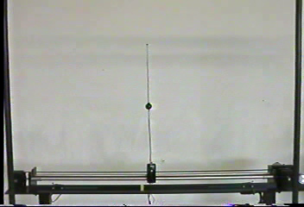
Double Inverted Pendulum (1979)
1

Slide 4
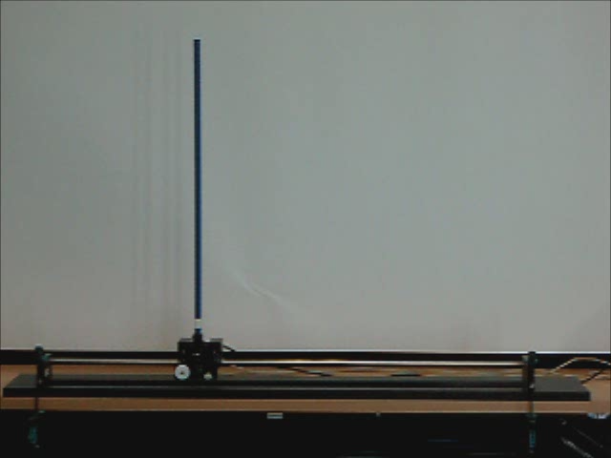
Inverted Pendulum (IP)
1

Slide 5
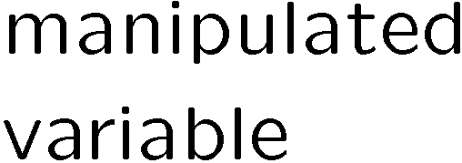
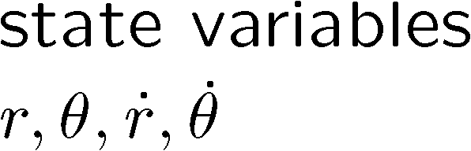
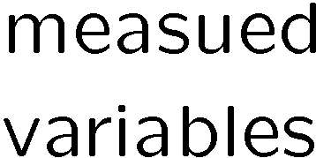
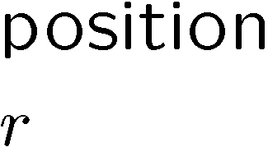
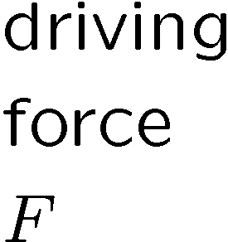






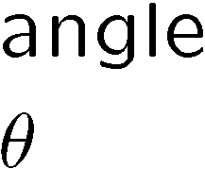


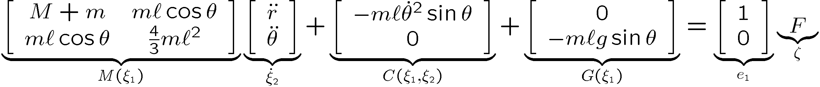
Inverted Pendulum
1
Under-actuated System

Slide 6
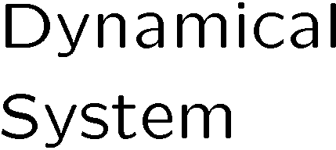
Under-actuated System
1
SISO (Single-Input Single-Output) System
1-input
1-output
MIMO (Multi-Input Multi-Output) System
m-inputs
p-outputs
m<p ⇒ Under-actuated System
  controlled variables as many as manipulated m-variables based on measured p-variables
If you chase after two rabbits, you won't catch either.

Slide 7



Andersen’s Approach
1
SISO#2
SISO#1

Slide 8
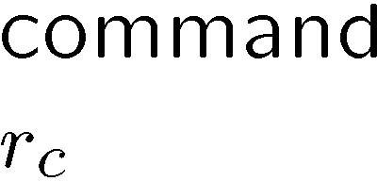

Position Control of a Cart
1
Unity feedback is used to correct the error
between given command and current position.

Slide 9
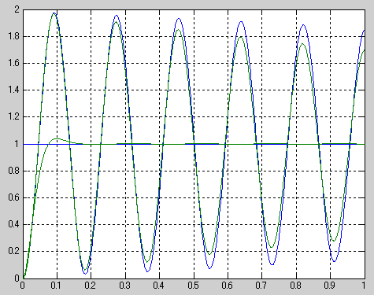
How to Regulate the Oscillation?
1
Step Response
（small dumping）
Step Response
(desired)
identified

Slide 10







Which action regulates the oscillation?
PID Control of a Cart (Motor/Ship)
1
I-Action
P-Action
D-Action

Slide 11
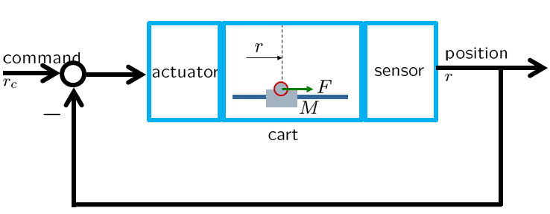
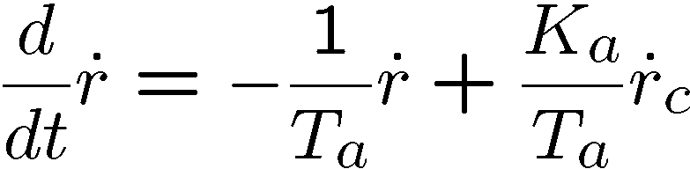
Andersen’s Approach (Step 1)
1
Position Controlled Cart

Slide 12
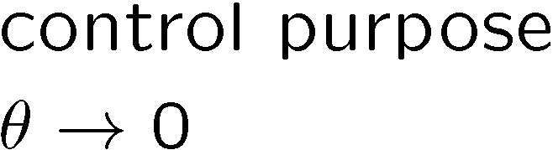
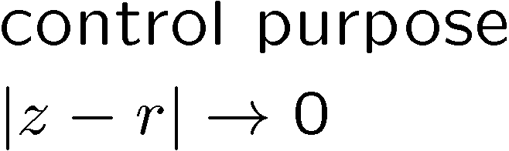
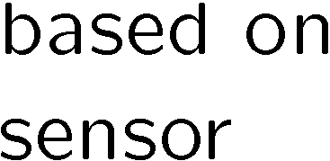
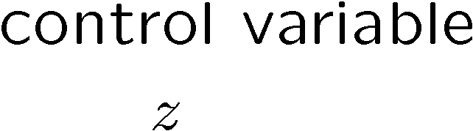

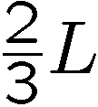
Which is easier to control?
1
Type 1
Type 2

Slide 13
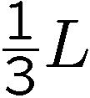

Andersen’s Approach (Step 2)
1
Pinching the point,
Adjust a control gain
to stop the oscillation.

Slide 14

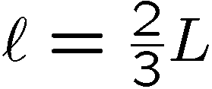

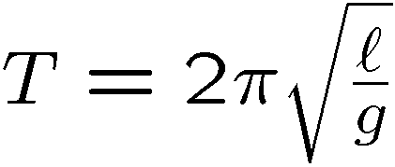
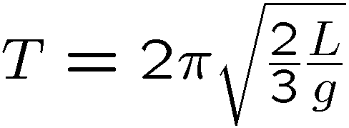
The Same Period of Pendulums
1
Simple Pendulum
Rigid Pendulum
Find the length ell to realize the same period as the rigid pendulum.

Slide 15
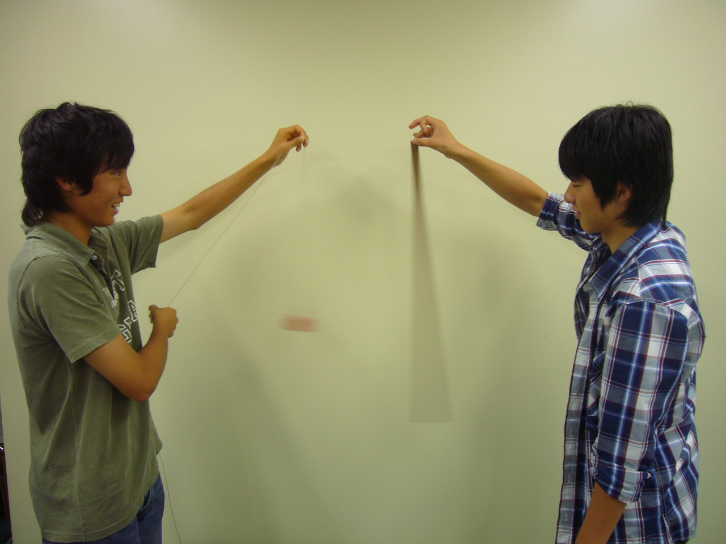
The Same Period of Pendulums
1

Slide 16
Center of Impact
1
move
quickly
move
quickly
Center of
impact
The controlled variable should be
such a physically unmovable point,
what we call, a node.

Slide 17

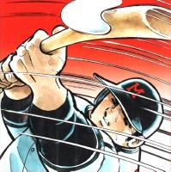
Examples of Center of Impact
1
Hit a ball to get the minimum impact on hands.

Slide 18
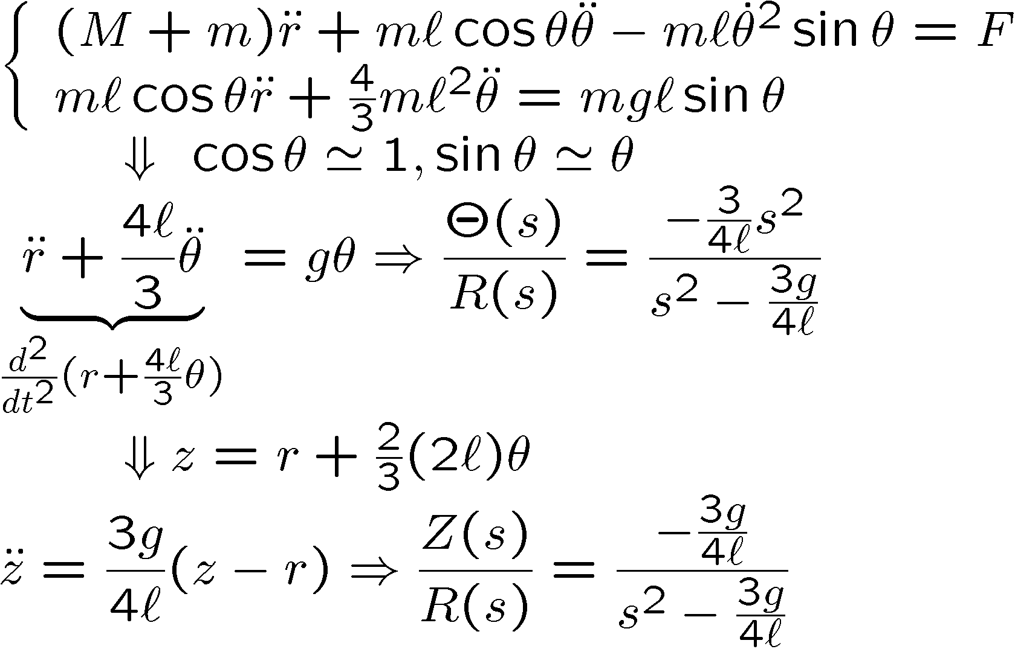
Finding a Controlled Variable
1
non-minimum
phase
minimum
phase

Slide 19
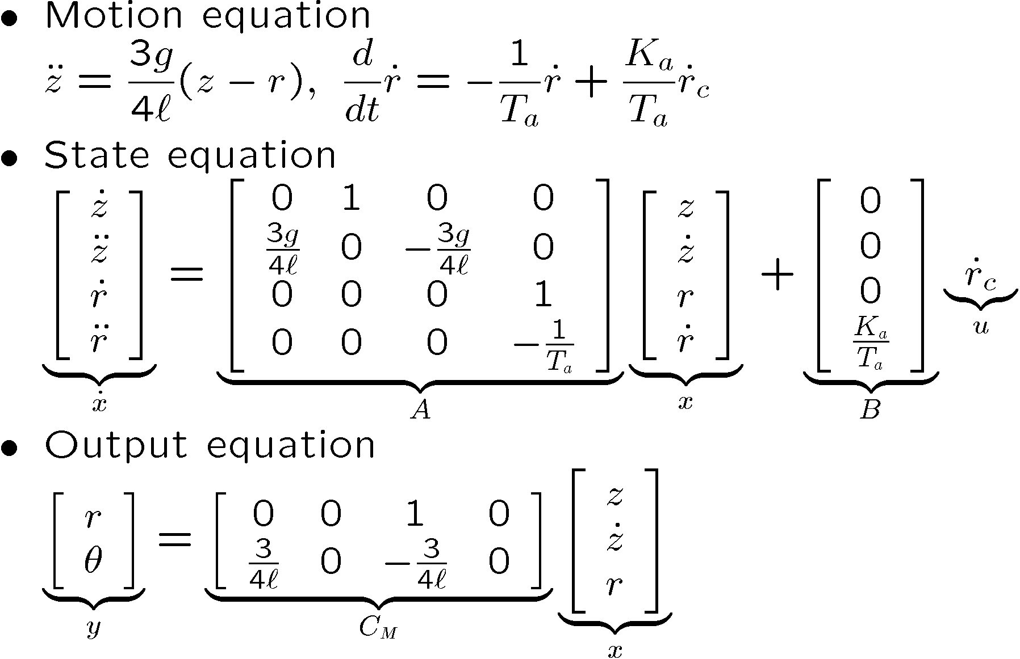
Velocity Input Model
1
velocity
input
This model is obtained as a sub-product.
But the usefulness will be noticed later.

Slide 20



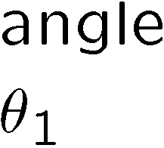



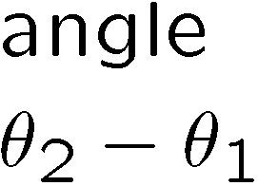
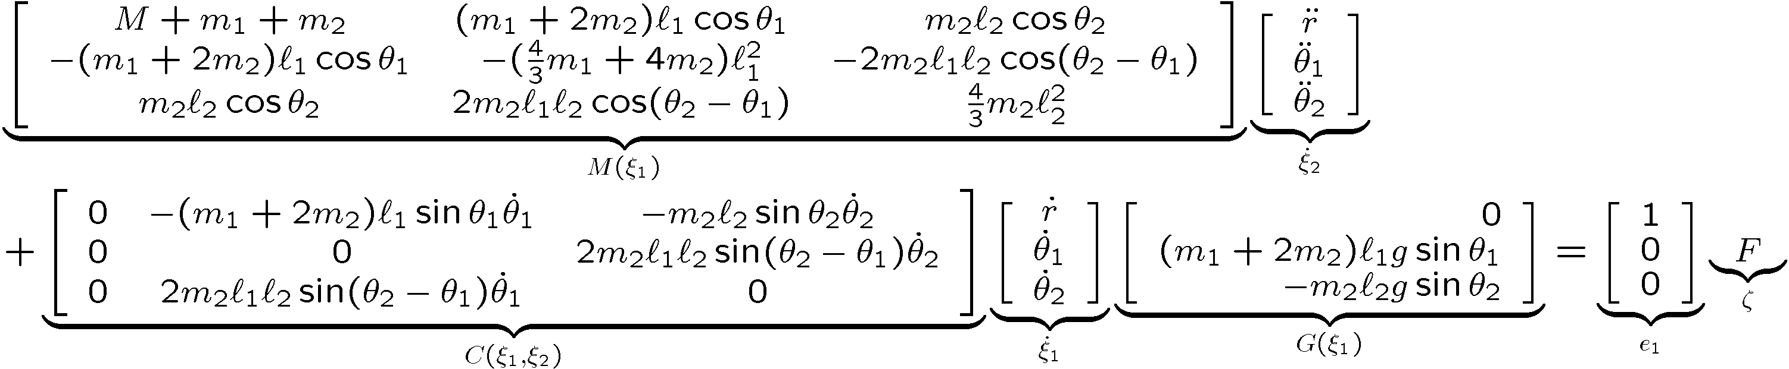
Double Inverted Pendulum
1
Under-actuated System

Slide 21


Andersen’s Approach
1
SISO#3
SISO#2
SISO#1

Slide 22
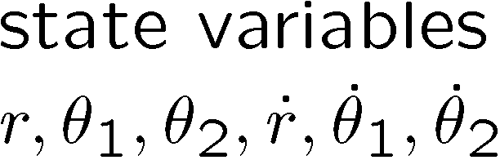

Control System for DIP
1

Slide 23
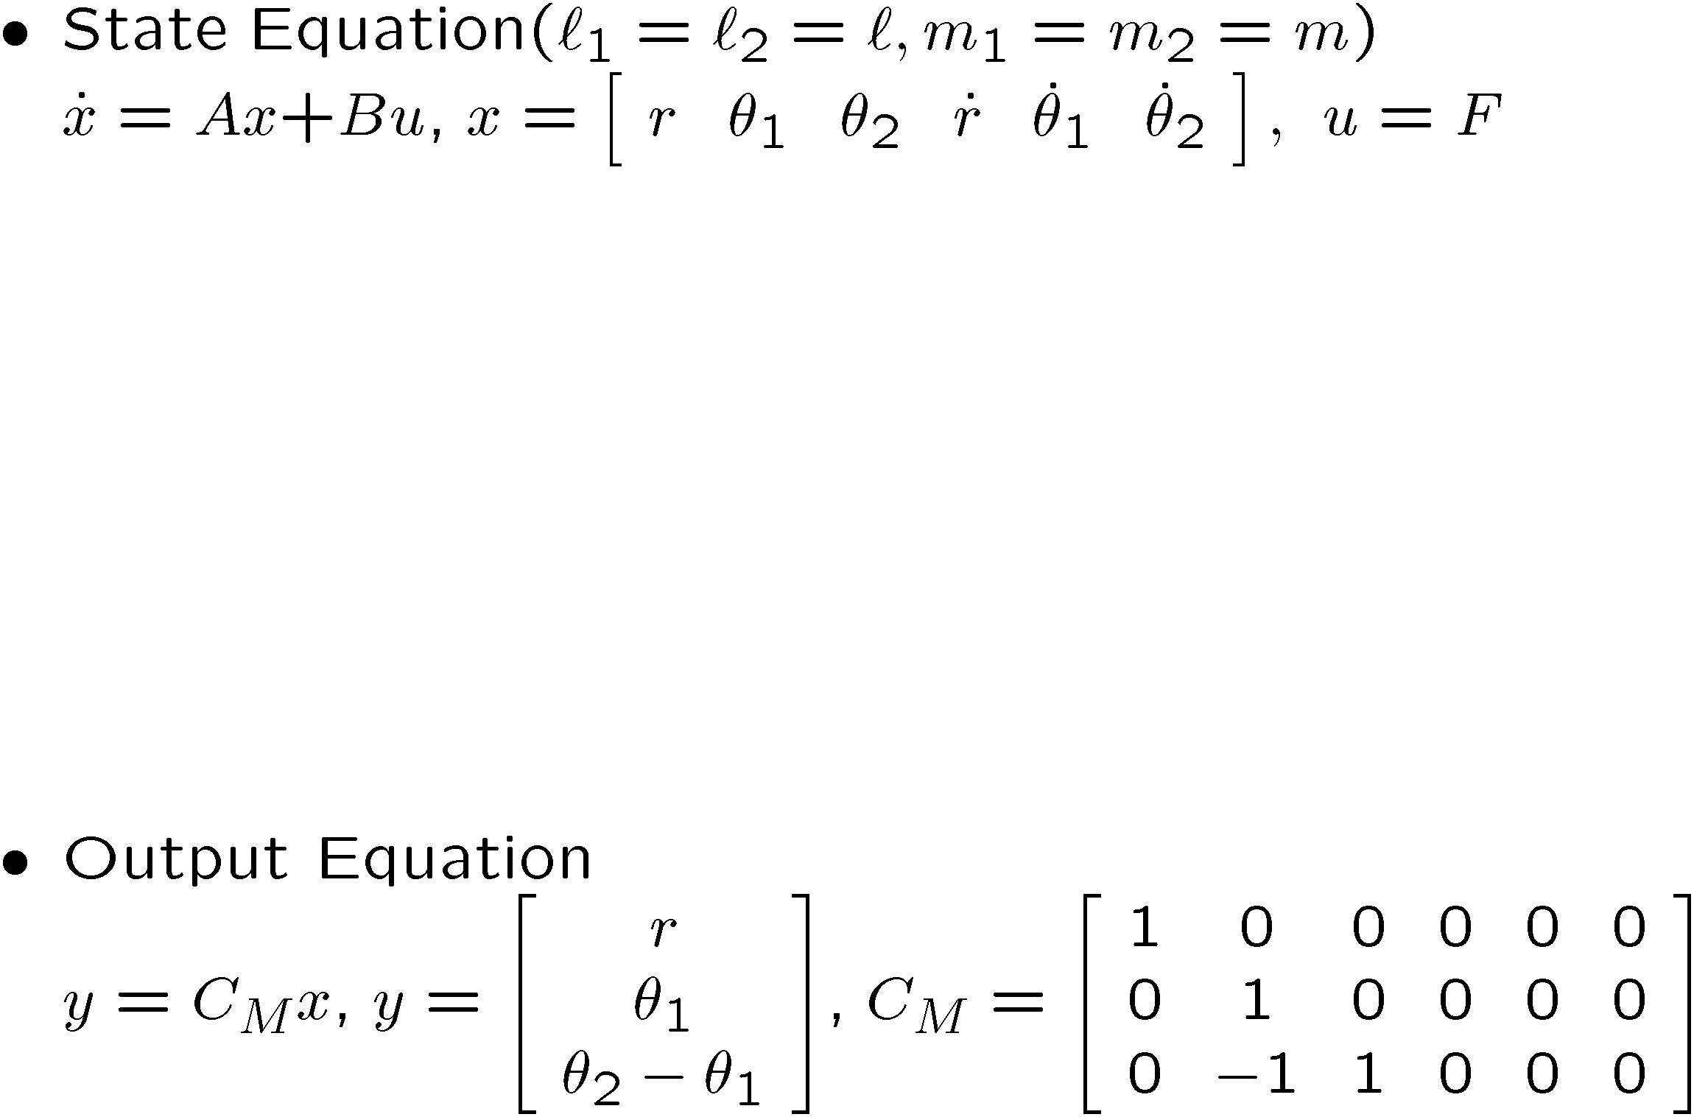
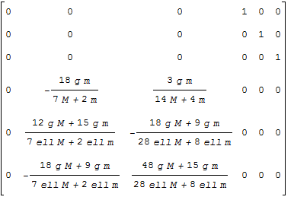
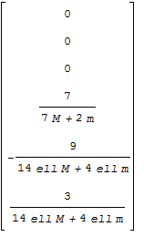
LTI Model for DIP
1

Slide 24
Control System for IP
1

Slide 25
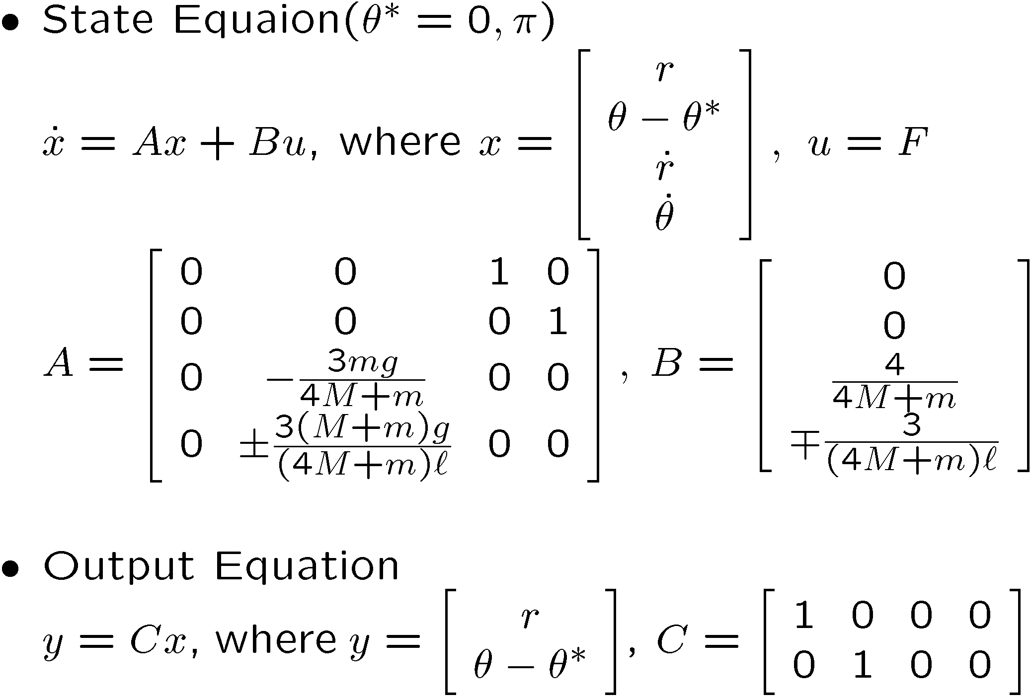
LTI Model for IP
1

Slide 26















LTI Control by LQI Design Method
1

Slide 27
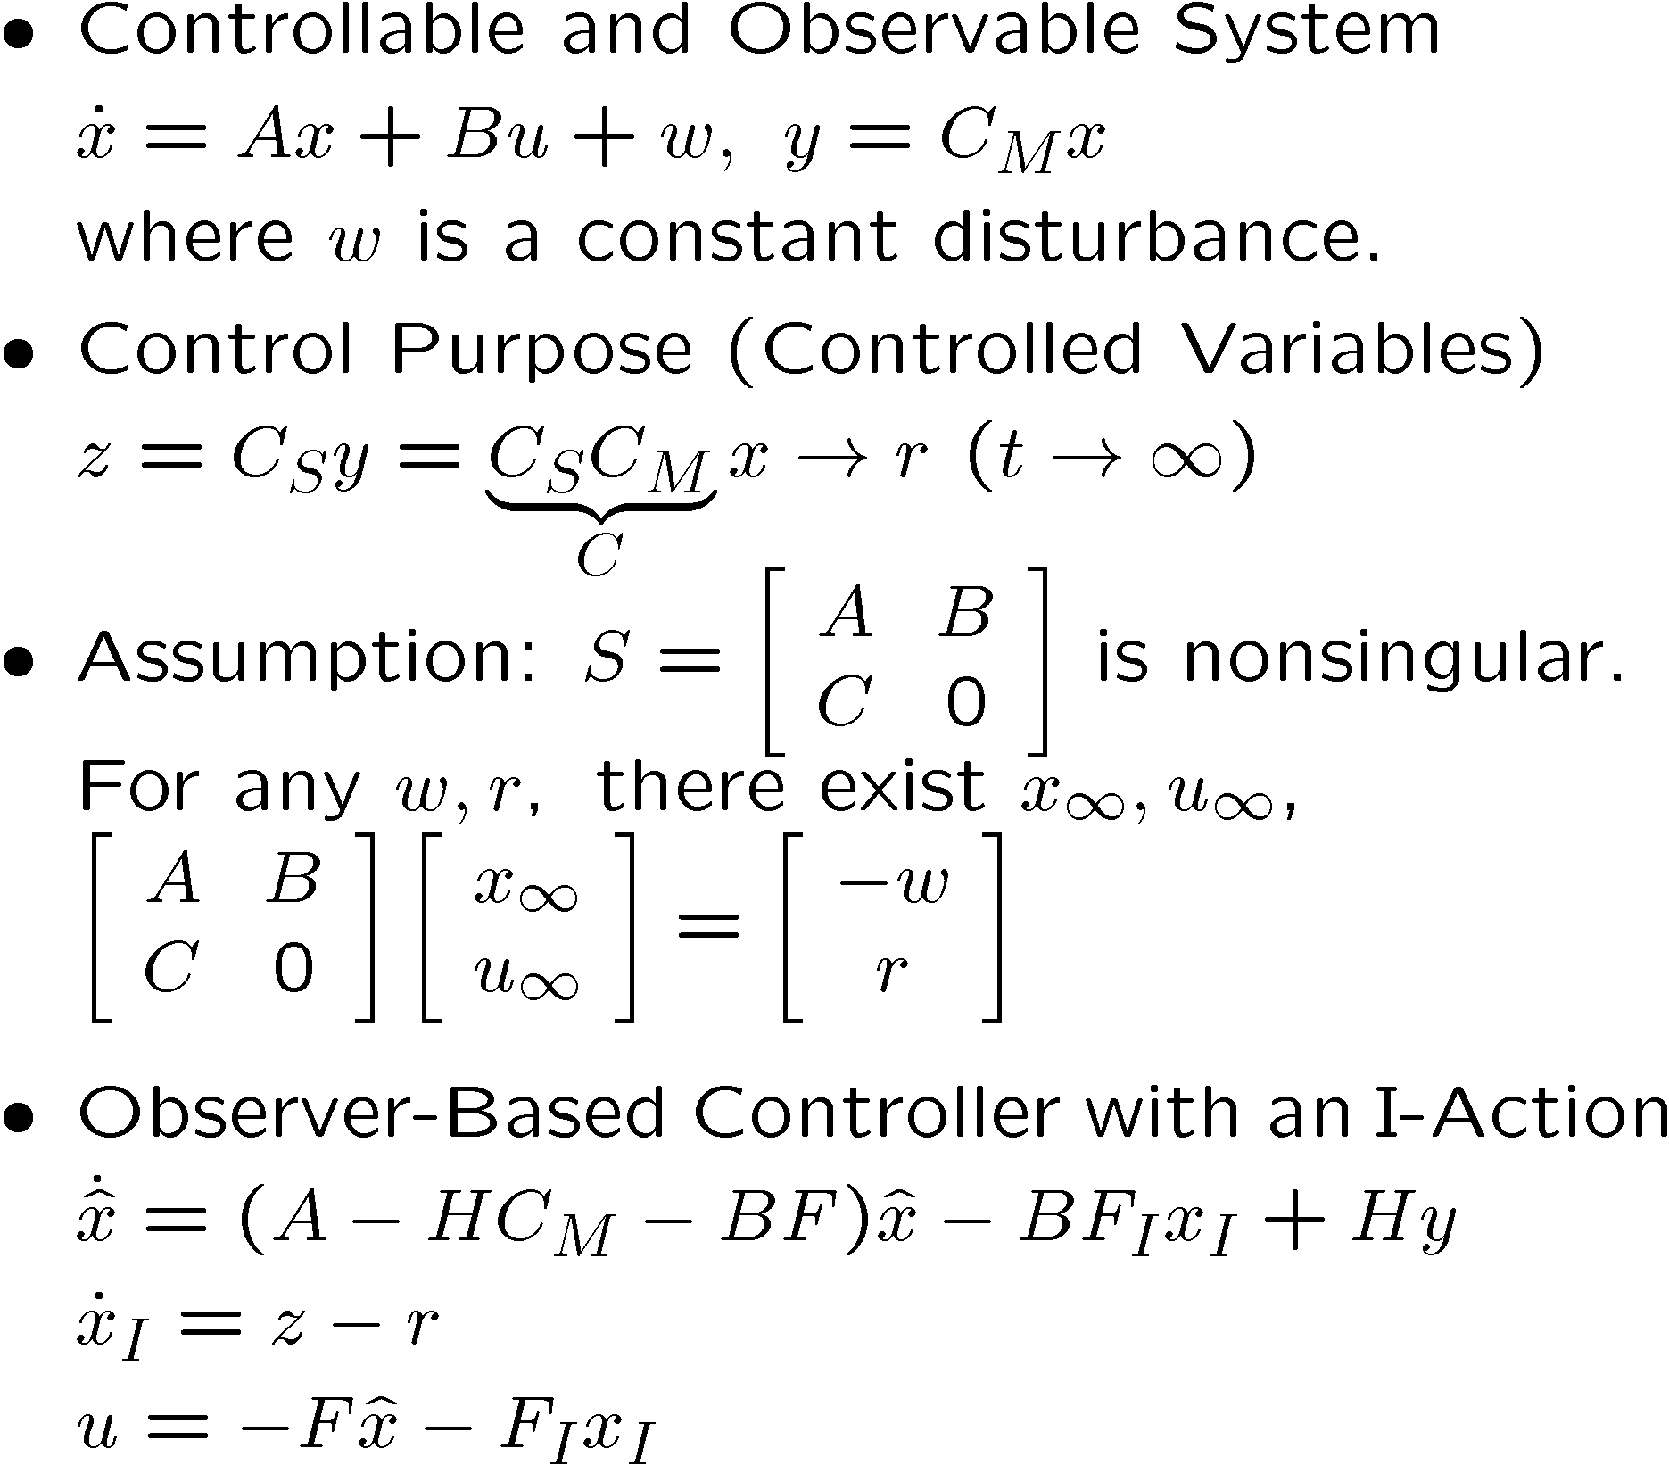
OBC with an I-Action
1

Slide 28
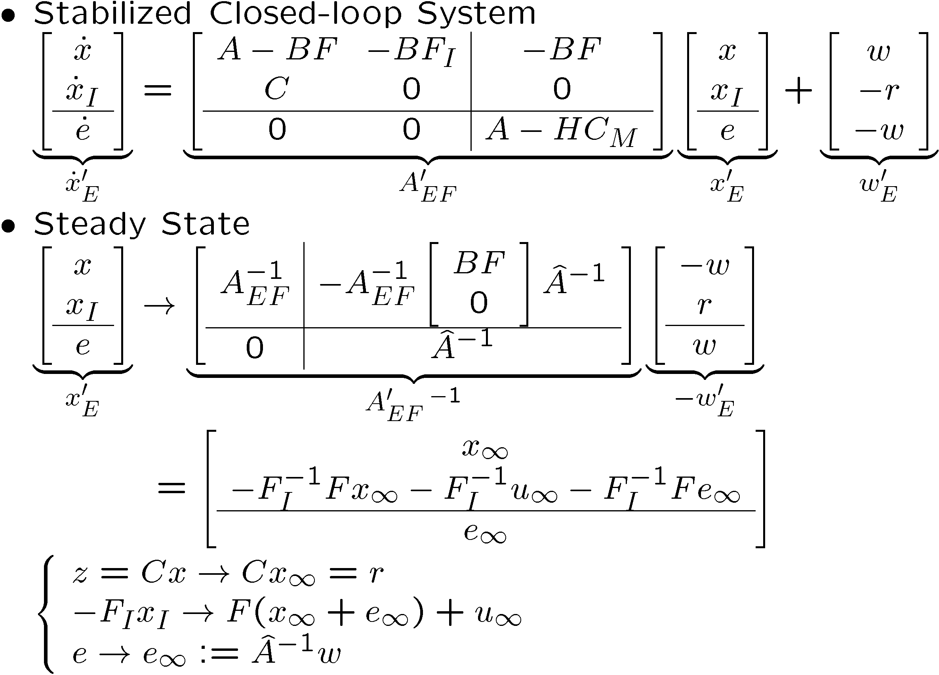
Steady State Analysis
1

Slide 29
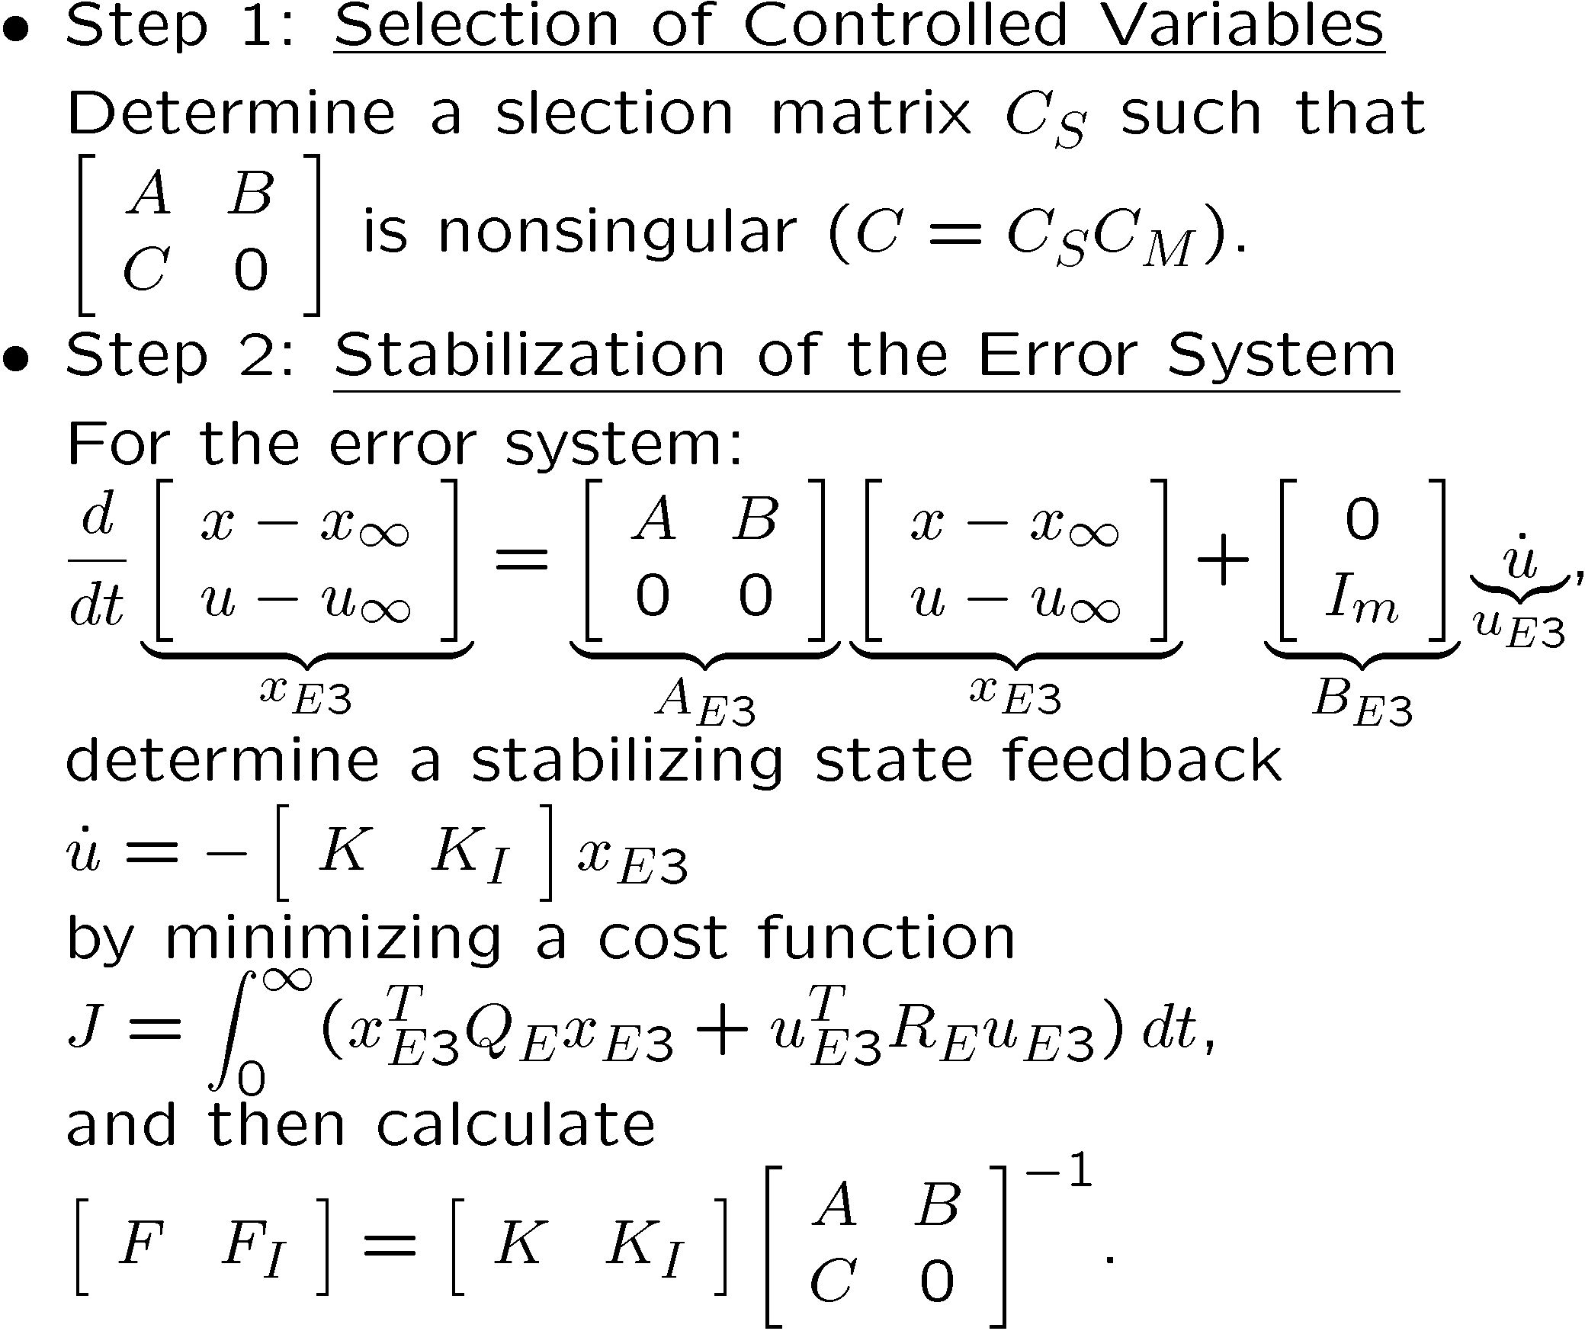
LQI Design Method (1)
1

Slide 30
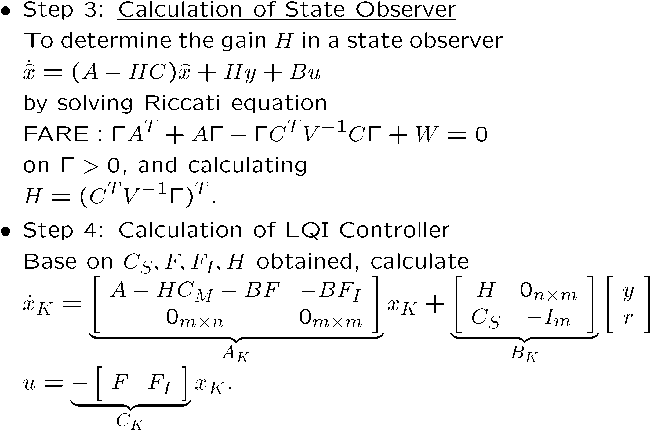
LQI Design Method (2)
1

Slide 31
Double Inverted Pendulum (1979)
1

Slide 32
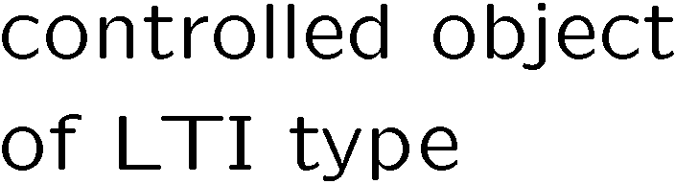


Outline
  LQI Control
  Linear-Quadratic-Integral Design of Linear-Time-Invariant Control
1
  LPV Control
  Linear-Matrix- Inequality Based Design of Linear-Parameter-Varying Control
2

Slide 33
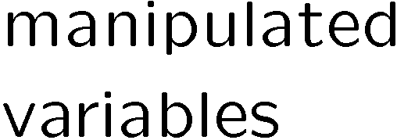
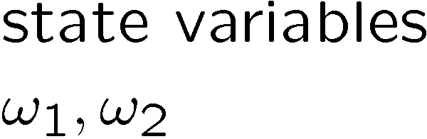
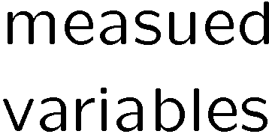

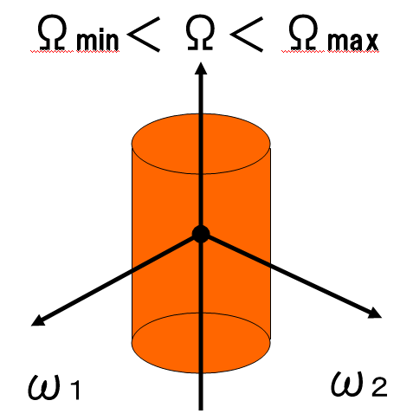



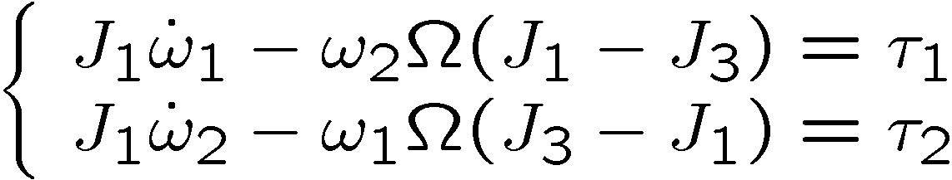
Spinning Body
2
Under the z-angular velocity variation,
regulate the disturbed x&y-angular velocities.

Slide 34
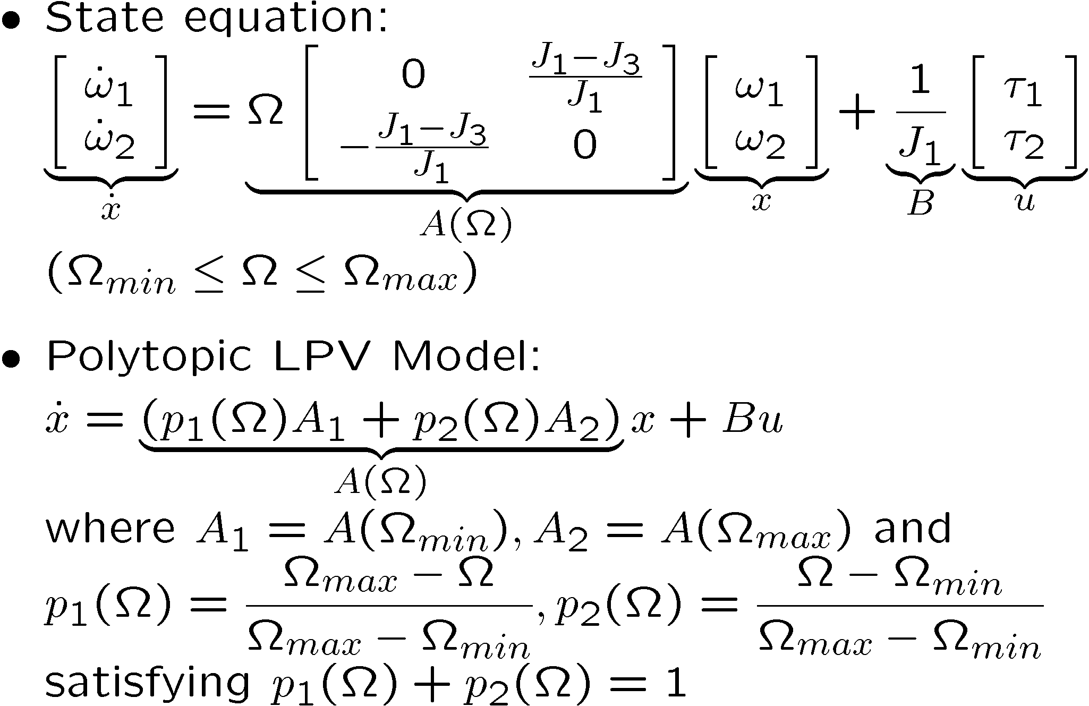
LPV Model
2
varying parameter

Slide 35
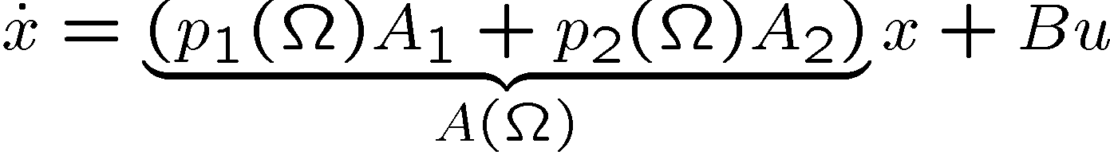






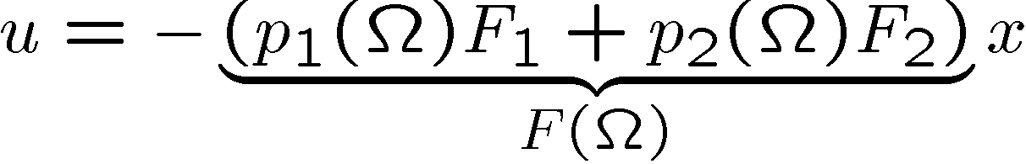
LPV Control
2
Vertex#1
Vertex#2
#1
#2
#1
#2
Vertex#1
Vertex#2
The interpolation of two vertex controllers doesn’t guarantee the closed-loop stability.

Slide 36
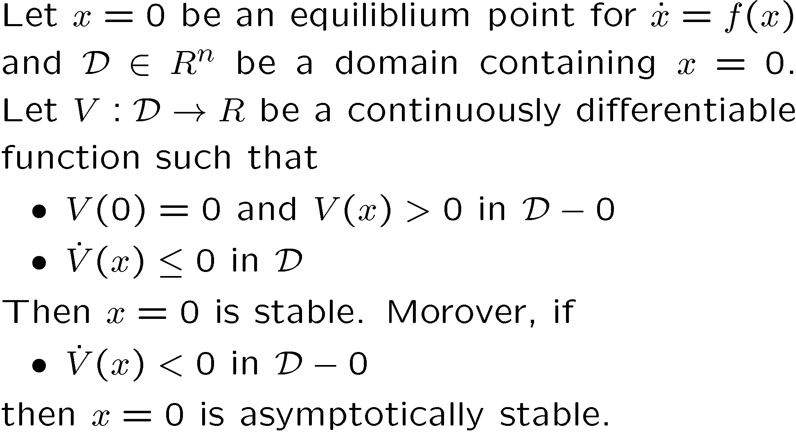
Lyapnov Stability Theorem

Slide 37
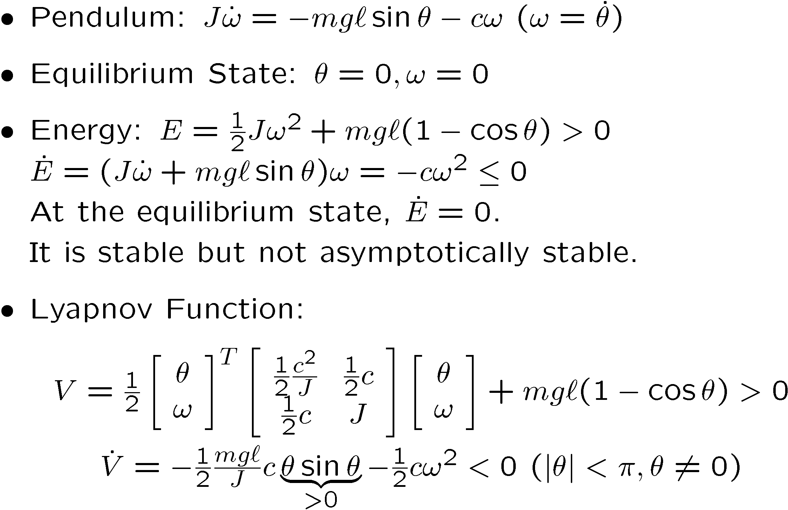
Example of Lyapnov Function

Slide 38









Design Specification
2

Slide 39


CLPS by LPV SF
2

Slide 40

LMI-Based Design of LPV SF
2

Slide 41






LMIs for SF
2

Slide 42

No Control
2

Slide 43

LTI Control (SF)
2

Slide 44


LPV Control (SF)
2

Slide 45


Quasi-LPV Control (SF)
2

Slide 46

Arm-Driven IP (ADIP,1997)
2

Slide 47





Equilibrium States for ADIP
2
The horizontal movement is reduced.

Slide 48




Wide-range Stabilization of ADIP
2
Under-actuated System

Slide 49



LTI Model for ADIP
2

Slide 50






Velocity Controlled Actuator
2

Slide 51

LPV Model for ADIP
2
varying
parameter
velocity
input

Slide 52

Control System for ADIP
2
#1
#2
#1
#2

Slide 53

Arm-Driven IP (1997)
2

Slide 54
Outline
  LQI Control
  Linear-Quadratic-Integral Design of Linear-Time-Invariant Control
Applications
1
  Underwater Vehicle
  Flexible Riser
  Azimuth thrusters
  Nomoto’s Model
  Wind Turbine
3
4
5
6
7
  LPV Control
  Linear-Matrix- Inequality Based Design of Linear-Parameter-Varying Control
2

Slide 55

Underwater Vehicle: DELTA
3
Wide-area survey:
Towing mode for wide scanning
Self-propulsive mode for local investigation
Notes:
I would like to introduce an underwater vehicle of delta-wing type, which has 2 thrusters and 4 sensors.
The mission is a wide-area survey.
For fast movement, this can be operated as a towed vehicle. The depth is controlled by weight shifting mechanism.
For slow movement, this can be operated as a self-propulsive vehicle.
In this case, two thrusters must be controlled in order to keep the attitude based on measuring the roll, pitch and yaw angels.

Slide 56







Underwater Vehicle (DELTA)
3

Slide 57


Control System for DELTA
3

Slide 58

Exp#1 (LQI Control, 1992)
3

Slide 59

Exp#2 (Manual and LQI Controls)
3

Slide 60
Diving by Linear Control
3
①Decreasing thrust
Pitching
proportional to
the target depth
②Increasing thrust

Slide 61
Diving by Scheduling Control
3
①Decreasing thrust
Pitching
independent of
the target depth
②Increasing thrust

Slide 62
Physical Parameters of DELTA
3
Hydrodynamic
Coefficients

Slide 63

Parameter Sensitivities
3

Slide 64









Parameter Uncertainties
3
Notes:
This shows the measured values of Zq’ and Mq’ corresponding to the reduced frequencies.
From these, we can identify the parameter intervals in which the true value exists.

Slide 65

LPV Model of DELTA
3
Notes:
Before getting the polytopic model, we need the affine model.
Zq and Mq are given by these formula.
The forward velocity U enters into the dumping matrix in affine manner.
Therefore we obtain this affine model.

Slide 66
Control System for DELTA
3
#4
#3
#1
#2
#4
#3
#1
#2

Slide 67

Exp#3 (LTI Control, 1m to 3m)
3

Slide 68

Exp#4 (Q-LPV Control, 1m to 3m)
3

Slide 69

Exp#5 (LTI Control, 1m to 4m)
3

Slide 70

Exp#6 (Q-LPV Control, 1m to 4m)
3

Slide 71

Exp#7 (LTI Control, 5m to 1m)
3

Slide 72

Exp#8 (Q-LPV Control, 5m to 1m)
3

Slide 73

Exp#9 (Q-LPV Control)
3

Slide 74
Outline
  LQI Control
  Linear-Quadratic-Integral Design of Linear-Time-Invariant Control
Applications
1
  Underwater Vehicle
  Flexible Riser
  Azimuth thrusters
  Nomoto’s Model
  Wind Turbine
3
4
5
6
7
  LPV Control
  Linear-Matrix- Inequality Based Design of Linear-Parameter-Varying Control
2

Slide 75

CHIKYU: Deep-sea Drilling Vessel
4
Length : 210m
Breadth : 38m
Gross tonnage : 57,087tons
Open the new frontier of earth and life science for future of mankind
by revealing the system of major earthquakes, global changes, origin of life
(C)JAMSTEC/CDEX
Notes:
This is the first riser equipped deep-sea drilling vessel named CHIKYU, which means EARTH in Japanese.
The length is 210m, the breadth is 38m, and the gross tonnage is 57,087tons. The height from ship bottom is 130m.
The mission is to open the new frontier of earth and life science for future of mankind by revealing the system of major earthquakes, global changes, origin of life.

Slide 76



CHIKYU: Riser Pipe Units & BOP
4
Length :27m
Diameter :1.2m
(C)JAMSTEC/CDEX
Notes:
The riser pipe units with length 27m and diameter 1.2m are connected to reach the total length several thousands m.
The total riser pipe behaves like a flexible structure because of its thin string feature.
The BOP makes safe drilling even where there is unexpected flow from a well.

Slide 77



CHIKYU: DPS & Azimuth Thrusters
4
(C)JAMSTEC/CDEX
(C)JAMSTEC/CDEX
(C)JAMSTEC/CDEX
Notes:
The vessel has 6 azimuth thrusters and DPS.
In order to conduct the stable and speedy reentry operation, we need to give appropriate position commands to DPS.

Slide 78

CHIKYU: Drill House
4
Notes:
This is a Drill House to control the reentry operation.
Using ROV, he can observe the motion behavior of the LMRP.
The driller is communicating with the DPS operator and the ROV operator.

Slide 79

CHIKYU: Operations
4

Slide 80









CHIKYU: Landing Operation
4
2１0m
Drill
House
Wind
Wave
Current
200m
DPS
2000m
1.2m
VIV
unknown deviation
ROV
BOP
Entry Corn
Notes:
The reentry operation is conducted by moving a riser pipe hanged off and positioning LMRP just above BOP.
We consider a calm sea state with no wind and no wave.
But we assume that the upper part of the riser pipe is bended by steady current.

Slide 81

CHIKYU: Reentry Operation
4
2１0m
Drill
House
Wind
Wave
Current
200m
DPS
2000m
1.2m
VIV
unknown deviation
Lower
ROV
LMRP
BOP
LowerMarine
RiserPackage
Notes:
The reentry operation is conducted by moving a riser pipe hanged off and positioning LMRP just above BOP.
We consider a calm sea state with no wind and no wave.
But we assume that the upper part of the riser pipe is bended by steady current.

Slide 82






CHIKYU: Reentry Control System
4
Current
Command
Position
Control
Allocation
ＤPS
推力配分
THR
Vessel
↓
Automatic
Controller
Upper-End
Inclined Angle
Riser
Lower-End
Position
CAMERA
Notes:
This slide shows a configuration of the reentry control system.
The drill operator is giving DPS commands based on the LMRP position observed.
As shown later, the manual control is not easy to achieve stable and speedy reentry.
This motivates us to design an automatic reentry controller and develop a reentry training simulator.

Slide 83
Why the reentry op is difficult?
4
moving
vessel
moving
vessel
Center of
impact
entry point
entry point

Slide 84

Reentry Control Problem
4
How to realize
the stability and
the performance
of reentry control
under no wind,
no current and
surface current
DPS not to be
modified

Slide 85




Control System for a Riser
4

Slide 86




State Variables q1,q2,…
4

Slide 87


Motion Equation
4

Slide 88

Velocity Input Model
4
velocity
input
varying
parameter

Slide 89

Experimental Set Up (5m)
4
  Current 1kt
  2.5m
  2.5m
  Stereo Camera
  2.5m
Notes:
As the second part of my talk, let me explain about an experimental set up.
The vessel is scaled down to this model of the length 3.8m. The length of the riser pipe model is 4.8m.
Here we have a stereo camera to measure the distance in real time precisely between the target and the lower end of the riser pipe model.
Also there is steady current of velocity 1 kt which bends the riser pipe model like this.

Slide 90


[90]
Riser Pipe Unit Model (5m)
4
CHIKYU: 210 m length
Vessel Model: 3.8 m length
Scaling factor : 1/55
Riser: 2500 m length
Riser Model: 4.8 m length
Scaling factor : 1/500
150
mm
Current
1st
2nd
3rd
4th
40mm
period
1/55 deviation
Dynamic Similarity
Geometric Similarity
Notes:
Note that the vessel scaling factor is 1/55. In the case of 2500m riser pipe, the length of the riser model is about 45m. Thus we must shorten it to less than 5m because of the depth limitation of water tank.
Each riser pipe unit model is designed such that the period of the 1st mode is about 3min based on dynamic similarity rule, and the deviation of the lower end under steady current is about 15cm based on geometric similarity rule.

Slide 91

Exp#1 (No Control for Riser)
4

Slide 92

Exp#2 (No Control with Current)
4

Slide 93

Exp#3 (Unity Feedback)
4

Slide 94

Exp#4 (LQI Control)
4

Slide 95

Exp#5 (LQI Control with Current)
4

Slide 96

Exp#6 (Overview)
4

Slide 97

Experimental Set Up (1m)
4
  Current 4kt
  １m

Slide 98


[98]
Riser Pipe Unit Model (1m)
4
CHIKYU: 210 m length
Assumed Vessel Model: 0.2 m length
Scaling factor : 1/1000
Riser: 2500 m length
Riser Model: 1 m length
Scaling factor : 1/2500
Current
22.5
mm
10mm
1st
2nd
3rd
4th
period
1/1000 deviation
Dynamic Similarity
Geometric Similarity

Slide 99

Experiments by 1m riser model
4

Slide 100
Concluding Remark
Control Tech.
Ocean Eng.
Having control technologies as the second axis will expand your engineering ability.
Thank you for your attention.

Slide 101
Outline
  LQI Control
  Linear-Quadratic-Integral Design of Linear-Time-Invariant Control
Applications
1
  Underwater Vehicle
  Flexible Riser
  Azimuth thrusters
  Nomoto’s Model
  Wind Turbine
3
4
5
6
7
  LPV Control
  Linear-Matrix- Inequality Based Design of Linear-Parameter-Varying Control
2

Slide 102











Thrust Components and Moment
5

Slide 103


CA Equation
5

Slide 104







CA Problem
5
Command
Position
Control
Allocation
ＤPS
推力配分
THR
Vessel

Slide 105

General Solution of CA Eq.
[105]
[105]
5
arbitrary
(2n-3)-vector
Notes:
105
105

Slide 106
Conventional Method
[106]
[106]
5
By norm minimization, each THR is apt to play the same role with the same thrust & direction.
Therefore for the small sign change under the weak
disturbance, each THR must always rotate for the forward and backward commands.
Forward
Backward
Notes:
106
106

Slide 107
CA with Rotated Angle Constraints
5
Conventional
Compensation
Proposal
1
1
1 1
0.5 0.5
1.5 1.5

Slide 108

Toy Problem on CA
5
X
No.2
No.1
No.3
Y
N

Slide 109




CA Simulation of Toy Problem
5
T1
T2
T3
Θ1
Θ2
Θ3

Slide 110

CA Experiment (1)
5

Slide 111

CA Experiment (2)
5

Slide 112
Outline
  LQI Control
  Linear-Quadratic-Integral Design of Linear-Time-Invariant Control
Applications
1
  Underwater Vehicle
  Flexible Riser
  Azimuth thrusters
  Nomoto’s Model
  Wind Turbine
3
4
5
6
7
  LPV Control
  Linear-Matrix- Inequality Based Design of Linear-Parameter-Varying Control
2

Slide 113




MOMOTO Model
6
Time lag
Parameter Uncertainty
Velocity Variation

Slide 114

Scheduled MOMOTO Model
6

Slide 115

Scheduled MOMOTO Model
6

Slide 116

Sate Equation
6

Slide 117





LPV Model with 3 Vertexes
6

Slide 118







LPV Control System
6
#2
#1
#3
#2
#1
#3

Slide 119


Design Specification
6

Slide 120











Interconnection with Integrator
6
Notes:
The plant structure is determined by the mixed sensitivity problem formulation.

Slide 121


CLPS by LPV OF
6

Slide 122

LMI Based Design of LPV OF
6

Slide 123

LMIs for OF Design
6

Slide 124

Scheduled PID Controller
6

Slide 125





LPV Control of MONOTO Model
6
Case2
Case1
Case3

Slide 126
Outline
  LQI Control
  Linear-Quadratic-Integral Design of Linear-Time-Invariant Control
Applications
1
  Underwater Vehicle
  Flexible Riser
  Azimuth thrusters
  Nomoto’s Model
  Wind Turbine
3
4
5
6
7
  LPV Control
  Linear-Matrix- Inequality Based Design of Linear-Parameter-Varying Control
2

Slide 127

HYWIND
7

Slide 128


風力発電機の制御問題
7
ミトルグルデンの洋上風力発電ファーム
風レンズ風車（九大風レンズ研究グループ）
風は強く吹いたり、全く吹かなかったり・・・
安定した発電を実現することが必要
最適回転数制御による高効率化の実現
Notes:
１章で述べましたように、近年、風力発電が大きな注目を浴びています。しかしながら、その安定した発電を実現するためには発電の高効率化が必要不可欠です。そこで本研究では最適回転数制御による高効率化についての検討を行いました。なお、本研究はすべて九州大学で開発された風レンズ風車を対象として扱っています。

Slide 129




風力発電機の運転モード
7
: カットイン風速
: 定格風速
: カットアウト風速
: 定格出力
Notes:
風力発電機の運転モードは大きく分けて４つに分けて考えることが出来ます。モード１と呼ばれる領域はカットイン風速までの風速域です。この領域では風が弱すぎるために、ロータそのものが回転することが出来すに、発電をすることが困難です。次に、カットイン風速から定格風速領域までの風速領域が、モード２領域です。この領域では、風エネルギーを最大限、獲得する必要があります。次に、定格風速からカットアウト風速までの領域が、モード３領域です。この領域では、発電電力が定格電力を超えることなどから、発電電力が定格値になるように出力制御を行う必要があります。そして最後に、カットイン風速以上の風速領域がモード４領域です。この領域では、もはや危険であるために、強制的に稼動を止める必要があります。

Slide 130


風力発電機の数学モデル
7
バッテリー
V（m/s）
ω（rad/s）
風力発電機モデル
風レンズ風車の空力トルク特性
風レンズ風車の数学モデル
可変負荷により任意電流値が実現可能
Notes:
本研究で取り扱う風レンズモデルは、簡単な、DC-発電機モデルです。このモデルは、次のような２つの式で表すことが出来ます。最初の式が、機械部、二番目の式が電気部の式です。機械部の第１項は風車特有の空力トルク成分を表すものです。こちらのグラフに、風レンズの空力トルクを表しております。この軸（右奥軸）が、回転数、この軸（左奥軸）が風速、縦軸がトルク値を表しております。明らかに、風速と回転数に依存した非線形性を有していることが分かります。
本研究で取り扱います風レンズ風車は、電流コントローラを有しており、瞬時に指令電流を実現できること、また、この風レンズ風車の制御問題の本質は、空力トルク特性の有する非線形性にあると考え、本研究では、機械部の式のみを風レンズの数学モデルとして考えることし、研究を行っています。

Slide 131




風力発電機のLPVモデル
7
Notes:
まず最初に、風レンズ風車の数学モデルを動作点周りでテイラー展開を行います。その結果、得られた式が、この式（下式）です。ここで、注目していただきたいのは、この状態方程式の第１項の係数成分が風速に応じて変動すると言うことです。

Slide 132

モード２の制御目的
7
風力エネルギーを最大限、獲得すること
風レンズの周速比が常に最適周速比となるように回転数制御
出力係数、トルク係数
制御目的：
周速比
Notes:
では、LPV制御系設計を行うために必要な、LPVモデリングについて説明します。モード２の制御目的は風力エネルギーを最大限獲得することです。こちらには、風レンズの出力係数曲線とトルク係数曲線を示しています。この図から、風力エネルギーを最大限獲得するには、出力係数曲線のピーク値で稼動すればよいということが分かります。よって、このピーク値の周速比を最適周速比と呼び、この最適周速比から最適回転数を次のように求めることが出来ます。したがって、制御目的とて、この回転数に追従制御を行えばよいということになります。

Slide 133


モード２のLPVモデル
7
モード２における風速の変動幅は
次の ポリトピック型LPVモデル を導出することができる
ただし、
Notes:
モード２においては、第１項の係数はこの風速値のみが変動することになります。一方で、モード２の風速変動領域がカットイン風速から、定格風速までの間であることを考慮しますと、次のようなポリトピック型LPVモデルを導出することが出来ます。ここで、P_{1}、P_{2}はそれぞれ、次のように表されます。

Slide 134



モード３の制御目的
7
風エネルギーから獲得したパワーを定格出力に抑える
出力係数、トルク係数
制御目的:
周速比
Notes:
次に、モード３の目的は、風の出力を定格値に抑え込むことです。一般的に、風のエネルギーは次のように表現することができますので、その値が、定格出力に等しいという関係から、動作点の周速比を求めることができ、最終的に、モード３の最適回転数を導出することができます。しかしながら、ここで大きな問題が発生します。

Slide 135



モード３のLPVモデル
7
図6．風速と係数Ａの関係
カットアウト風速時
実際のモード３のシステム変動
カットアウト風速と定格風速間
が線形システム変動の場合
定格風速時
ポリトピック型ＬＰＶモデルを導出することができない
Notes:
モード２においては、係数の風速成分のみが変動していましたので、ポリトピック型LPVモデルを容易に導出することができましたが、しかしながら、今回は、動作点の周速比も変動しますので、こちらの偏微分項も一緒に変動することになります。こちらのグラフには、第１項の係数成分の風速に対する変動の様子を表しております。非常に複雑に変動する様子が分かります。したがって、モード２と同様にして、ポリトピック型LPVモデルを導出することが出来ません。

Slide 136


モード３のLPVモデル
7
ＬＰＶモデリング問題を解決する１つのアプローチ
トルク係数曲線を２次関数近似
風速と回転数の２つのパラメータに線形依存した
風力発電機の状態方程式が導出される
Notes:
そこで、本研究では、１つの打開策としまして、トルク係数曲線を２次関数近似を行い、あらためて、状態方程式を導出し直しました。そこで得られた状態方程式がこちらです。この式から、風レンズモデルが、風速だけでなく回転数にも依存して決定されることが分かります。スケジューリング変数が一つ増えてしまいましたが、幸運にも、この式には、先ほど現れたような動作点における偏微分項が存在しません。

Slide 137




モード３のLPVモデル
7
カットアウト風速
風速
[m/sec]
定格風速
回転速度[rad/sec]
Notes:
モード３の風速変動は、定格風速からカットアウト風速までの領域ですので、前述しましたような最適回転数は次のような軌跡で表されます。つまり、先ほど導出した風レンズの状態方程式もこの軌跡に沿って変動すると考えられます。そこで、風レンズのシステム変動をポリトピック表現するために、この軌跡を包含するような三角形領域を設定しまし、ポリトピック型LPVモデルを導出しました。

Slide 138






数値シミュレーションによる検討
7
モード２の計算結果
モード３の計算結果
使用したフィールド計測風速データの時系列
従来制御方式によるアプローチ
線形パラメータ変動制御方式
Notes:
数値シミュレーションの結果をお見せします。風速データは九州大学応用力学研究所で計測されたフィールド計測データです。比較として従来制御方式の結果も付記しています。モード２の目的はエネルギーを最大限に獲得することにありますので、つまり最適周速比近傍で運転することで実現されます。そこで、グラフとしては周速比の時系列の結果を載せています。一方でモード３の目的は出力を300 [W]に維持することにありますので、出力の結果を載せています。両モード領域において従来制御方式と比較して線形パラメータ変動制御方式は最適稼動点近傍での運転を実現していることが確認されると思います。

Slide 140
Prof. Hiroyuki Kajiwara
He was born in 1952 in Japan.
He received the B.S. degree in Engineering
from Kyushu Institute of Technology in 1975,
the M.S. and Ph.D. degrees in Engineering
from Tokyo Institute of Technology in 1977 and 1985
respectively.
He was a research assistant
at Tokyo Institute of Technology, 1977-1982,
and an associate professor
at Okayama University, 1982-1990,
and at Kyushu Institute of Technology, 1990-1999.
Since 1999,
he has been a professor at Kyushu University,
in the dept. of marine systems engineering.

Slide 141
Summary (1)
1
Under-Actuated Systems (m<p)
  How to choose controlled variables based on measured variables (p), as many as manipulated variables (m)
Inverted pendulum (m=1)
  The center of impact can be chosen as a controlled variable.
  Based on this selection, a velocity-input model of IP can be obtained.
  This model can give a position/velocity command to the position/velocity-controlled actuator (by an integration).
(if you chase after two rabbits, you won't catch either)
(sampling from both worlds)

Slide 142
Summary (2)
2
Gain-Scheduling Control
  Parameter variation (to be measured)
  The interpolation of vertex controllers doesn’t guarantee the closed-loop stability in time-varying system
LPV Control
  How to get LPV model with varying parameter Ω
  How to design LPV control based on LMIs

Slide 143
HILS for Control System Design
3
DESIGN-PC (MATLAB/SIMULINK)
Step1) Development of Nonlinear Simulator
External Input
Evaluated Output
Controlled
Object
Manipulated Input
Measured Output
Controller
Step2) Design of Controller
Notes:
As the third part of my talk, let me explain about HILS approach to control system design.
At first, we must have a nonlinear simulator of the controlled object.
Based on the mathematical model linearized around an equilibrium state, we design a linear controller such that the closed-loop system satisfies stability and performance specifications.

Slide 144
Virtual Control Experiment
3
SIMULATOR-PC (Windows Target)
Step3) Real-Time Calculation of Nonlinear Simulator
External Input
Evaluated Output
Controlled
Object
Manipulated Input
Measured Output
AD
DA
CONTROLLER-PC (xPC Traget)
DA
AD
Controller
Step4) Implementation of Controller
Notes:
The most critical step in HILS approach is to divide the CLPS into the real time nonlinear simulator and the real time controller by means of electrical emulation of sensors and actuators.

Slide 145







Developing Training Simulator
3
Controlled Object
Virtual
Reality
Toolbox
Upper-End
Inclined Angels
Overview
Lower-End
Position
ＲＯＶ
Viewpoint
A
D
Vessel with Thrusters & Riser
D
A
Windows Target
D
A
DPS
Control Allocation
A
D
Controller
xPC Target
Operator
D
A
Reentry Guidance
A
D
Notes:
Adding virtual reality functions to the real time nonlinear simulator, we can construct a training simulator.
A guidance function is realized by utilizing the output of automatic reentry controller like this.

Slide 146

Training Simulator Developed
3
ROV View
Overview
Deviation
Vessel
DPS&CA
Guide
Notes:
As the forth part of my talk, let me explain about a training simulator we developed.
The slide shows a developed training simulator.
Here you can see 3 PCs: 1st PC for the vessel real time simulator, 2nd PC for DPS & CA, 3rd PC for guidance function.

Slide 147



Experimental Parts
3
  7m riser pipe model
  and
  vessel model
150
mm
40mm
Notes:
These are photos of experimental parts.
The riser pipe model is made by connecting the short pipe units.
The upper end is hinged here, the inclined angles can be measured by rotational sensors.
This is a waterproof camera.

Slide 148

Experimental Set Up (1m)
3

Slide 149

Vortex Induced Vibration (VIV)
3

Slide 150


Conventional Method (c=0)
4
スラスト力は適切 | スラスタが回転する

Slide 151


Quasi-Optimal Solution (1)
4
スラスト力が過大 | 首振りは余り行わない

Slide 152


Quasi-Optimal Solution (2)
4
スラスト力は適切 | 首振角制約をほぼ満たす

Slide 153


Optimal Solution
4
スラスト力は暫定法と同様適切 | 首振角制約を厳守

